Slide 1
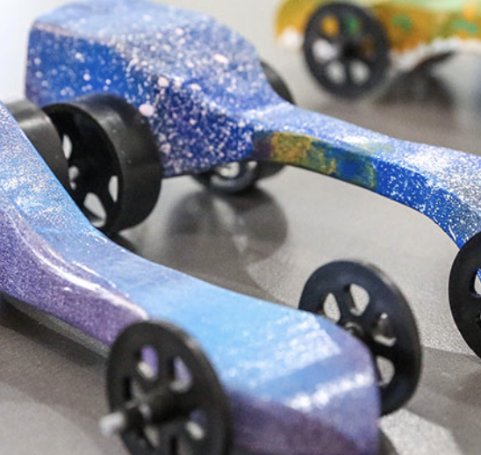
Unit 1: C02 Racers
Problem:
You are an automotive design engineer in the research and development department of the NIS Automotive Company. You have been assigned the task of designing the new, fuel efficient, aerodynamically sound, stylish, and futuristic automobile for the company. You will be in charge of the designing, constructing, and testing of the new vehicle. All cars in the company will be compared for excellence in design, craftsmanship, aerodynamics, and the fastest racing time.

Slide 2
Unit 1: C02 Racers
Design Brief
Design and build a C02 Racer within the design specifications and material constraints to race against the other teams
The dragster needs to travel down the track while being propelled by a CO2 cartridge. It must be held and launched by the teacher using an eye hook to position the dragster and the launching apparatus to puncture the CO2 cartridge.
The dragster can be any shape as long as it it carved from the given blanks and meets the size requirements. The design should reflect the research that has been done in regards to aerodynamics and mechanical function.

Slide 3
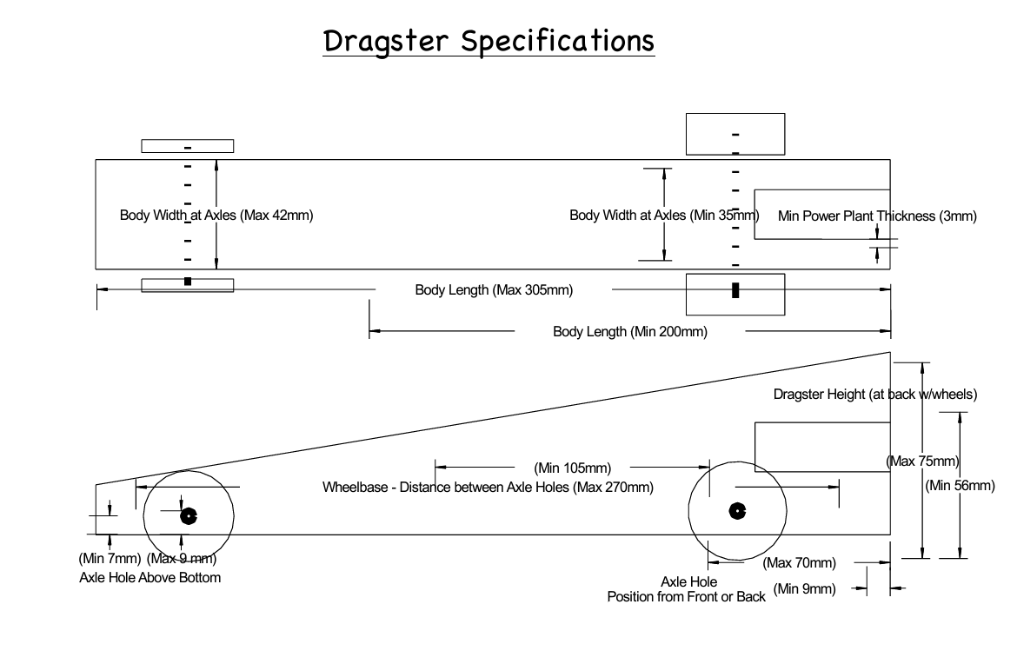
Design Specs

Slide 4
How does one work?

Slide 5
Task 1: Research
Look up the following words and paste in a definition. Add your home language:
Aerodynamics
Drag
Streamline
4. Potential energy
5. Kinetic energy

Slide 6
Task 1: Research
Provocation:
What do you think are the top 3 factors affecting the speed of the dragster?

Slide 7
Task 1: Research
Newton's 3 Laws, with a bicycle - Joshua Manley
Part 1: Analyzing Inertia (Newton’s 1st Law)
The video states that "Inertia" is the resistance to change.
The "Start-Up" Problem: Why requires more energy to take the first step of a run than it does to keep running at a steady speed?
Sentence Starter: It requires more energy to start because the object is at rest and wants to __________. To change this state, you must overcome __________.
Design Application: Imagine your CO2 racer is sitting on the starting line. It has a mass of 150g. What must the CO2 cartridge provide to break the car's inertia?
Answer: The cartridge must provide an unbalanced F__________.
Part 2: Proportional Reasoning (Newton’s 2nd Law)
The video explains the equation: Force = Mass × Acceleration ($F=ma$).
The "Constant Force" Scenario: In our project, every student uses the exact same CO2 cartridge. This means the Force is constant (it does not change). If Force stays the same, but you increase the Mass of your car, what happens to the Acceleration?
Sentence Starter: According to Newton's Second Law, if Force is constant and Mass increases, the Acceleration will __________ because Mass and Acceleration have an __________ relationship.

Slide 8
Task 1: Research
Newton's 3 Laws, with a bicycle - Joshua Manley
Mathematical Proof:
Car A has a mass of 50g.
Car B has a mass of 100g.
Both are pushed with 10N of Force.
Calculate: Which car accelerates faster, and by how much?
Answer: Car ___ accelerates ___ times faster than Car ___.
Part 3: Vector Analysis (Newton’s 3rd Law)
The video explains Action and Reaction pairs.
The Direction Paradox: To move the bicycle Forward, the tires must apply a force to the ground in which direction? Explain why using the concept of "Reaction."
Sentence Starter: To move forward, the tires must push __________. The ground reacts by pushing __________ with an __________ amount of force.
The "Earth" Question: The video claims the Earth "barely moves" when the bike pushes it. Why does the bike move a lot, but the Earth moves a little, even though the Force is the same? (Hint: Use Newton's 2nd Law).
Sentence Starter: Even though the force is equal, the Earth does not accelerate visibly because its __________ is extremely large compared to the bicycle.

Slide 9
Task 1: Research
Newton's 3 Laws, with a bicycle - Joshua Manley
Part 4: The Design Hypothesis (Criterion B Preparation)
Synthesize all three laws.
The Winning Strategy: Based on this video, write a hypothesis for your CO2 dragster. To get the fastest time, what must you minimize and what must you maximize?
Sentence Starter: To achieve the highest acceleration, I must minimize the __________ of the car to reduce the resistance to the Force. However, I must ensure the wheels maintain contact with the ground to utilize the __________ force (Newton's 3rd Law).

Slide 10
Task 1: Research
Watch this video https://www.youtube.com/watch?v=189TD4czV3s
Answer these questions
Part 1: Vocabulary Match
Match the word to the definition.
Word | Definition
1. Gravity | A. The force that pulls the car down to the ground.
2. Friction | B. The "push" or "pull" on an object.
3. Mass | C. When the air slows down the car.
4. Air Resistance | D. How heavy the car is.
5. Force | E. Rubbing between the wheels and the track.

Slide 11
Task 1: Research
Watch this video https://www.youtube.com/watch?v=189TD4czV3s
Answer these questions
Part 2: Newton’s 1st Law (Objects at Rest & Motion)
Circle the correct answer.
At the Start: The car sits on the launcher. It is at rest. What provides the "Unbalanced Force" to make it move?
A. Gravity
B. The Air Pressure
C. The Wheels
While Moving: The car slows down because of three unbalanced forces. Circle the three forces below:
Gravity
Magic
Friction
Electricity
Air Resistance
Design Check: Why did we put plastic straws around the axles?
Sentence Starter: We used straws to reduce ____________________.

Slide 12
Task 1: Research
Part 3: Newton’s 2nd Law (Force = Mass x Acceleration)
The video says the Force (Air Pressure) is the same for everyone (75 psi).
The Rule:
More Mass (Heavy Car) = [ Faster / Slower ] Acceleration
Less Mass (Light Car) = [ Faster / Slower ] Acceleration
The Reason:
Sentence Starter: A heavier car is slower because the air pressure has to do more ___________ to get it moving.
Part 4: Newton’s 3rd Law (Action & Reaction)
Fill in the blanks using the words in the box.
[ Forward / Backward / Wall / Air ]
At the Start (The Launch):
Action: The ___________ pushes out the back of the car.
Reaction: The car moves ___________ with the same amount of force.
At the Finish (The Stop):
Action: The car hits the foam ___________.
Reaction: The car bounces ___________.

Slide 13
Task 1: Research
Answer 1 paragraph each
Explain how each of the above Laws of Motion is important to your CO2 dragster
2. What causes a C02 dragster to decelerate?
3. What happens to kinetic energy when your car stops at the end of the track?

Slide 14
Task 1: Research
4. If there were no air or no gravity, what would happen to the car once it was started?
5. Explain what happens when you puncture a C02 canister
6. How do you determine the speed of the C02 dragster?

Slide 15
Bibliography
Add ASA style bibliography on this page for ALL sources used.
If you used AI also include which one you used, and how you used it including the prompt you used.

Slide 16
Marking Guide
Level | Description of Physics Understanding | Key "Design Science" Vocabulary Required | Academic Honesty & AI Usage
0 | The student does not reach a standard described by any of the descriptors below.
1-2 | Limited Understanding • Q1-5: Student states Newton's Laws but does not explain how they apply to the dragster. Answers are very short or copied from Google. • Q6: Student cannot explain how to calculate speed. • Scaffold Check: Student relies heavily on translation tools without editing. | Must use basic terms: • Speed / Fast • Push / Pull • Heavy / Light | Limited Honesty • No sources listed. • AI is used to write the answer for the student (Red Light).
3-4 | Adequate Understanding • Q1-5: Student explains the laws and makes basic connections to the car (e.g., "Friction makes the car stop"). • Q6: Student mentions "Speed" and "Time" but may miss the formula. • Scaffold Check: Explanations are correct but may lack scientific depth. | Must use these terms: • Friction / Air Resistance • Weight / Mass • Force • Newton's 1st, 2nd, 3rd Law | Adequate Honesty • A list of URLs is provided. • AI is used, but the student does not show the prompt.
5-6 | Substantial Understanding • Q1-5: Student explains the relationship between variables (e.g., "According to F=ma, if I lower the mass, the acceleration increases"). Correctly identifies that gas pressure creates thrust. • Q6: Correctly identifies $Speed = \frac{Distance}{Time}$. • Scaffold Check: Student uses the physics to justify design choices. | Must use these terms: • F=ma (Formula) • Inertia • Action / Reaction • Drag / Aerodynamics • Pressure | Substantial Honesty • Sources are cited (Website name + URL). • AI Declaration: Student states "I used AI to check my grammar" or "I used AI to explain the concept."
7-8 | Excellent Understanding • Q1-5: Student provides detailed scientific reasoning. Correctly identifies energy transfer (Kinetic $\to$ Heat/Sound) and theoretical physics (Vacuum = no drag = constant velocity). • Q6: Details the tools needed for measurement (light gates or stopwatch + measured track). • Scaffold Check: Answers demonstrate high-level applied physics. | Must use these terms: • Kinetic Energy / Potential Energy • Conservation of Energy • Thrust • Vacuum / Gravity • Velocity | Excellent Honesty • Full bibliography included. • AI Transparency: Student includes the specific prompt used and the original AI output, showing how they modified it.

